Slide 1
Introduction to Keras
Francois Chollet March 9th, 2018

Slide 2
What’s Keras?

Slide 3
Keras: an API for specifying & training differentiable programs
Keras API
TensorFlow / CNTK / MXNet / Theano / ...
GPU
CPU
TPU
High level neural network API written in python and capable of running on top of TensorFlow or Theano.

Slide 4
Keras is the official high-level API of TensorFlow
tensorflow.keras (tf.keras) module
Part of core TensorFlow since v1.4
Full Keras API
Better optimized for TF
Better integration with TF-specific features
tf.keras
TensorFlow
GPU
CPU
TPU
Estimator API
Eager execution
etc.

Slide 5





Who makes Keras? Contributors and backers

Slide 6
What’s special about Keras?
A focus on user experience.
Large adoption in the industry and research community.
Multi-backend, multi-platform.
Easy productization of models.

Slide 7
250,000
Keras developers

Slide 8
2x
Year-on-year growth

Slide 9










Industry traction
etc...

Slide 10
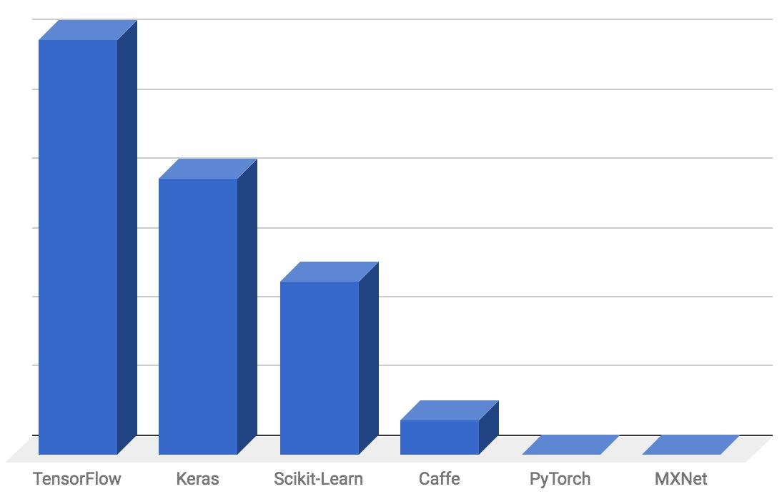
Hacker News jobs board mentions - out of 964 job postings
Startup-land traction

Slide 11
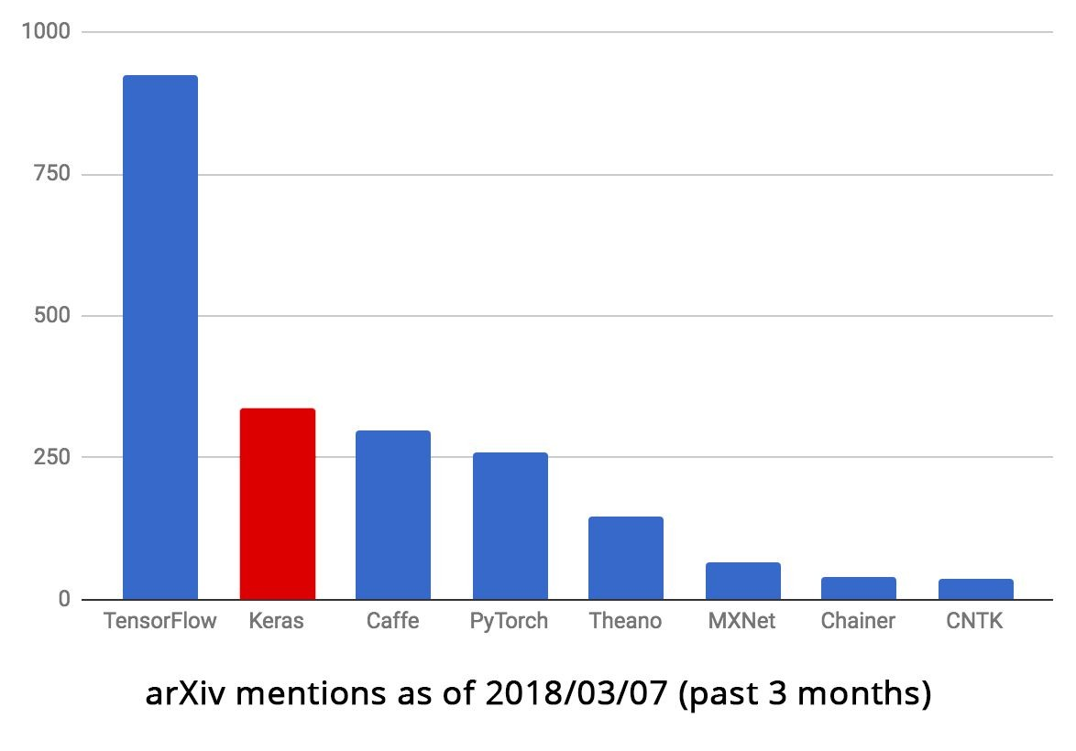
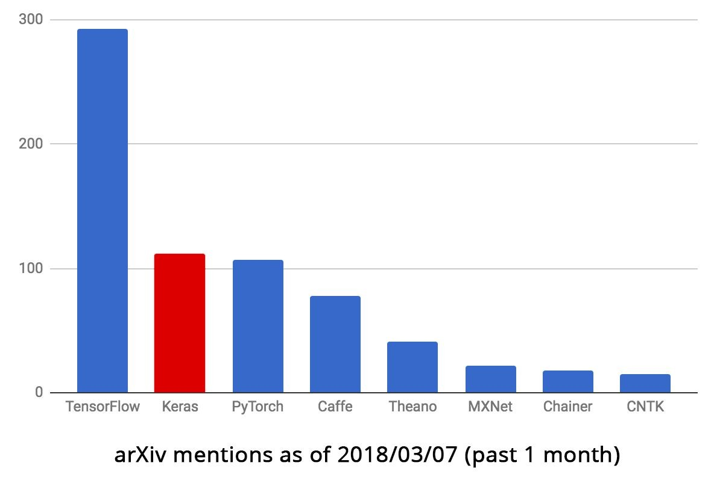
Research traction

Slide 12
The Keras user experience
Keras is an API designed for human beings, not machines. Keras follows best practices for reducing cognitive load: it offers consistent & simple APIs, it minimizes the number of user actions required for common use cases, and it provides clear and actionable feedback upon user error.
This makes Keras easy to learn and easy to use. As a Keras user, you are more productive, allowing you to try more ideas than your competition, faster -- which in turn helps you win machine learning competitions.
This ease of use does not come at the cost of reduced flexibility: because Keras integrates with lower-level deep learning languages (in particular TensorFlow), it enables you to implement anything you could have built in the base language. In particular, as tf.keras, the Keras API integrates seamlessly with your TensorFlow workflows.

Slide 13
Keras is multi-backend, multi-platform
Develop in Python, R
On Unix, Windows, OSX
Run the same code with…
TensorFlow
CNTK
Theano
MXNet
PlaidML
- ??
CPU, NVIDIA GPU, AMD GPU, TPU...

Slide 14
Largest array of options for productizing models
TF-Serving
In-browser, with GPU acceleration (WebKeras, Keras.js, WebDNN…)
Android (TF, TF Lite), iPhone (native CoreML support)
Raspberry Pi
JVM
Go build cool AR apps with Keras + TF + CoreML + ARKit

Slide 15
How to use Keras:
An introduction

Slide 16
Three API styles
The Sequential Model
Dead simple
Only for single-input, single-output, sequential layer stacks
Good for 70+% of use cases
The functional API
Like playing with Lego bricks
Multi-input, multi-output, arbitrary static graph topologies
Good for 95% of use cases
Model subclassing
Maximum flexibility
Larger potential error surface

Slide 17
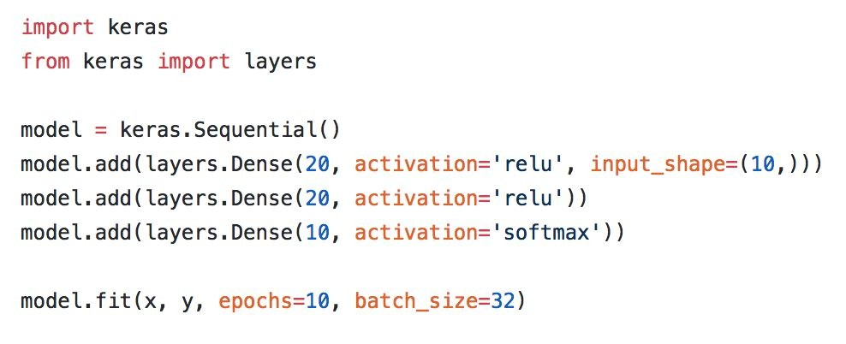
The Sequential API

Slide 18
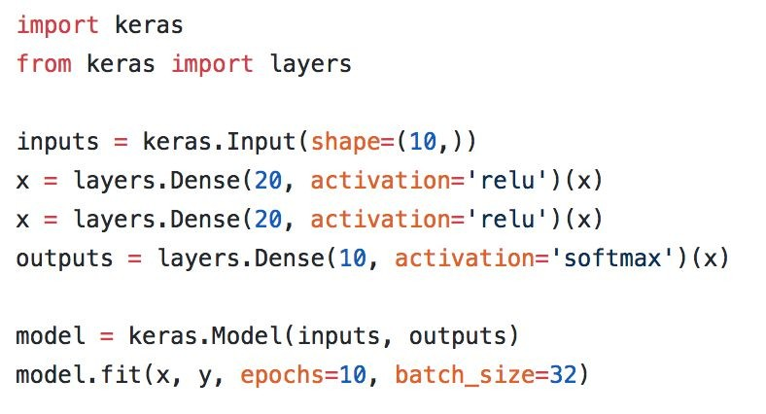
The functional API

Slide 19
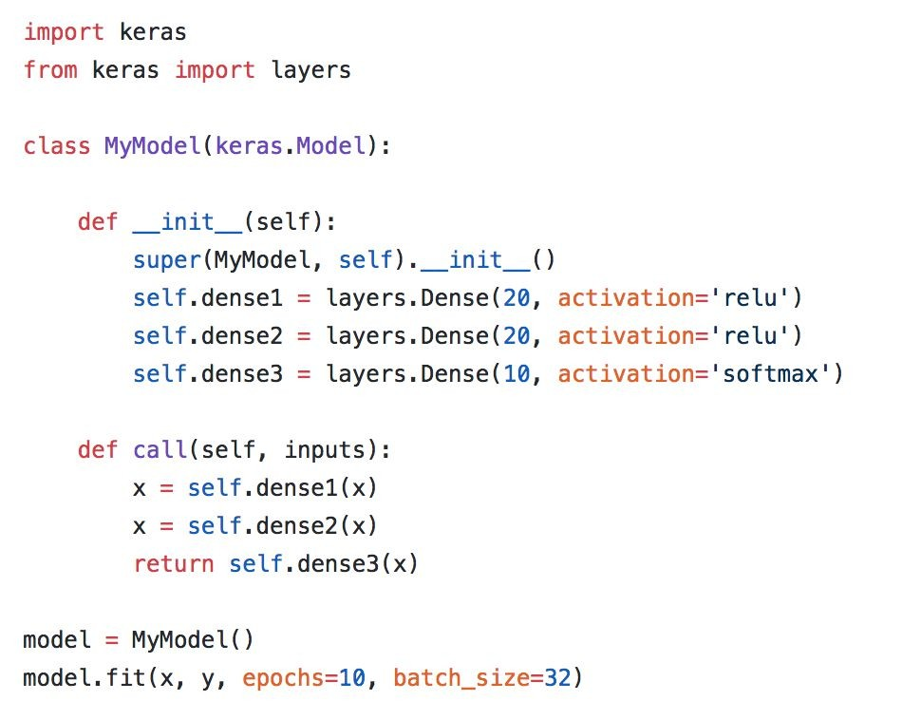
Model subclassing

Slide 20
Remember: use the right tool (API) for the job!

Slide 21
Deep Learning Model Life-Cycle

Slide 22
5-Step Model Life-Cycle
Define the model
Select the type of model that you need
Choose the architecture or network topology (neuron,layers)
Compile the model
Select a loss function that you want to optimize
Select optimizer
Fit the model
Select the training configuration, (number of epochs, batch_size)
Evaluate the model
Make predictions.

Slide 23
5-Step Model Life-Cycle
Define the model
# example of a model defined with the sequential api
from tensorflow.keras import Sequential
from tensorflow.keras.layers import Dense
# define the model
model = Sequential()
model.add(Dense(100, input_shape=(8,)))
model.add(Dense(80))
model.add(Dense(30))
model.add(Dense(10))
model.add(Dense(5))
model.add(Dense(1))

Slide 24
5-Step Model Life-Cycle
Define the model
# example of a model defined with the functional api
from tensorflow.keras import Model
from tensorflow.keras import Input
from tensorflow.keras.layers import Dense
# define the layers
x_in = Input(shape=(8,))
x = Dense(10)(x_in)
x_out = Dense(1)(x)
# define the model
model = Model(inputs=x_in, outputs=x_out)

Slide 25
5-Step Model Life-Cycle
Compile the model
# compile the model
opt = SGD(learning_rate=0.01, momentum=0.9)
model.compile(optimizer=opt, loss='binary_crossentropy‘, , metrics=['accuracy'])
For a list of supported optimizers: tf.keras Optimizers
For a list of supported Loss: tf.keras Loss Functions
For a list of supported metrics: tf.keras Metrics
The three most common loss functions are:
‘binary_crossentropy‘ for binary classification.
‘sparse_categorical_crossentropy‘ for multi-class classification.
‘mse‘ (mean squared error) for regression.

Slide 26
5-Step Model Life-Cycle
Fit the model
# fit the model
model.fit(X, y, epochs=100, batch_size=32, verbose=0)
Verbose=2 for simple report of model performance each epoch
Verbose=0 to turned off

Slide 27
5-Step Model Life-Cycle
Evaluate the model
# evaluate the model
loss = model.evaluate(X, y, verbose=0)
X,y are unseen data

Slide 28
5-Step Model Life-Cycle
Predict the model
# make a prediction
yhat = model.predict(X)
X is new data for which a prediction is required, e.g. where you do not have the target values

Slide 29
Example: building a video captioning model

Slide 30

Toy video-QA problem
“What is the man doing?”
packing
“What color is his shirt?”
blue

Slide 31
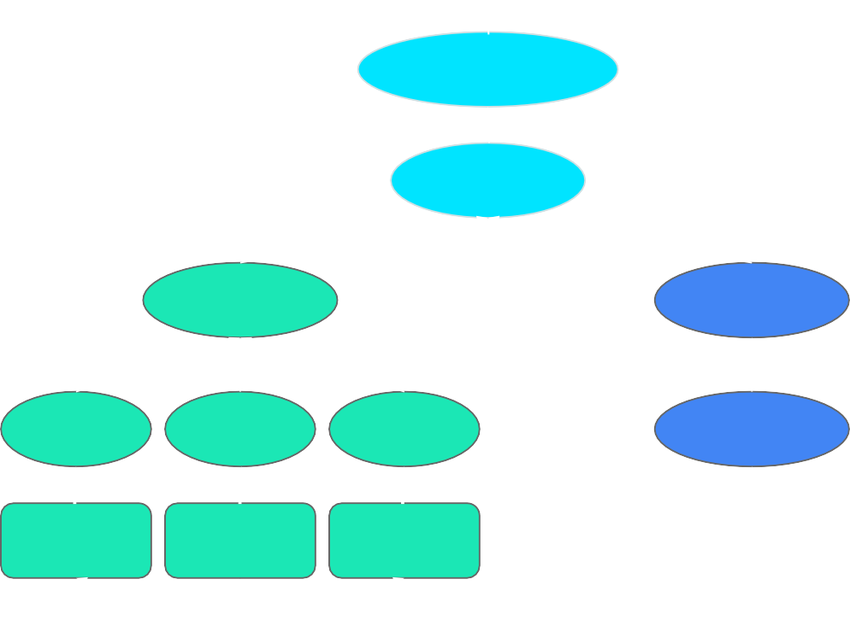
answer word
Classifier
Concat
LSTM
LSTM
CNN
CNN
CNN
Embed
frame
frame
frame
video
question

Slide 32
from frames to a vector
video vector
LSTM
CNN
CNN
CNN
frame
frame
frame
video

Slide 33
question vector
video vector
LSTM
LSTM
CNN
CNN
CNN
Embed
frame
frame
frame
video
question

Slide 34
answer word
Classifier
Concat
LSTM
LSTM
CNN
CNN
CNN
Embed
frame
frame
frame
video
question

Slide 35
answer word as one-hot vector
Dense
Dense Concat
LSTM
LSTM
TimeDistributed
InceptionV3
Embedding
video
as 5D tensor
question
as integer sequence

Slide 36
Turning frames into a vector, with pre-trained representations
import keras
from keras import layers
from keras.applications import InceptionV3
video = keras.Input(shape=(None, 150, 150, 3), name='video') cnn = InceptionV3(weights='imagenet',
include_top=False, pooling='avg')
cnn.trainable = False
frame_features = layers.TimeDistributed(cnn)(video) video_vector = layers.LSTM(256)(frame_features)

Slide 37
Turning frames into a vector, with pre-trained representations
import keras
from keras import layers
from keras.applications import InceptionV3
video = keras.Input(shape=(None, 150, 150, 3), name='video')
cnn = InceptionV3(weights='imagenet',
include_top=False,
pooling='avg')
cnn.trainable = False
frame_features = layers.TimeDistributed(cnn)(video) video_vector = layers.LSTM(256)(frame_features)

Slide 38
Turning frames into a vector, with pre-trained representations
import keras
from keras import layers
from keras.applications import InceptionV3
video = keras.Input(shape=(None, 150, 150, 3), name='video') cnn = InceptionV3(weights='imagenet',
include_top=False, pooling='avg')
cnn.trainable = False
frame_features = layers.TimeDistributed(cnn)(video) video_vector = layers.LSTM(256)(frame_features)

Slide 39
Turning frames into a vector, with pre-trained representations
import keras
from keras import layers
from keras.applications import InceptionV3
video = keras.Input(shape=(None, 150, 150, 3), name='video') cnn = InceptionV3(weights='imagenet',
include_top=False, pooling='avg')
cnn.trainable = False
frame_features = layers.TimeDistributed(cnn)(video) video_vector = layers.LSTM(256)(frame_features)

Slide 40
Turning frames into a vector, with pre-trained representations
import keras
from keras import layers
from keras.applications import InceptionV3
video = keras.Input(shape=(None, 150, 150, 3), name='video') cnn = InceptionV3(weights='imagenet',
include_top=False, pooling='avg')
cnn.trainable = False
frame_features = layers.TimeDistributed(cnn)(video) video_vector = layers.LSTM(256)(frame_features)

Slide 41
Turning a sequence of words into a vector
question = keras.Input(shape=(None,), dtype='int32', name='question') embedded_words = layers.Embedding(input_voc_size, 256)(question) question_vector = layers.LSTM(128)(embedded_words)

Slide 42
Predicting an answer word
x = layers.concatenate([video_vector, question_vector]) x = layers.Dense(128, activation=tf.nn.relu)(x) predictions = layers.Dense(output_voc_size,
activation='softmax', name='predictions')(x)

Slide 43
Setting up the training configuration
model = keras.models.Model([video, question], predictions) model.compile(optimizer=tf.AdamOptimizer(),
loss=keras.losses.categorical_crossentropy)
model.fit_generator(data_generator,
steps_per_epoch=1000, epochs=100)

Slide 44
Distributed, multi-GPU,
& TPU training

Slide 45
Distributed
Uber’s Horovod
Estimator API (TF built-in option)
Dist-Keras (Spark)
Also Elephas (Spark)

Slide 46
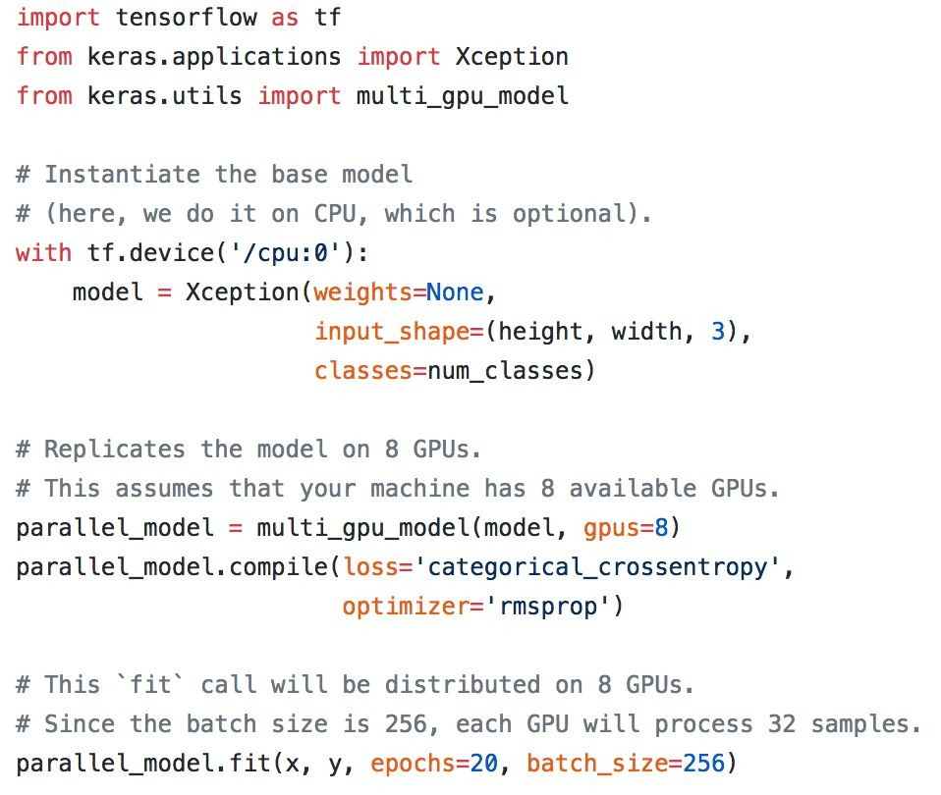
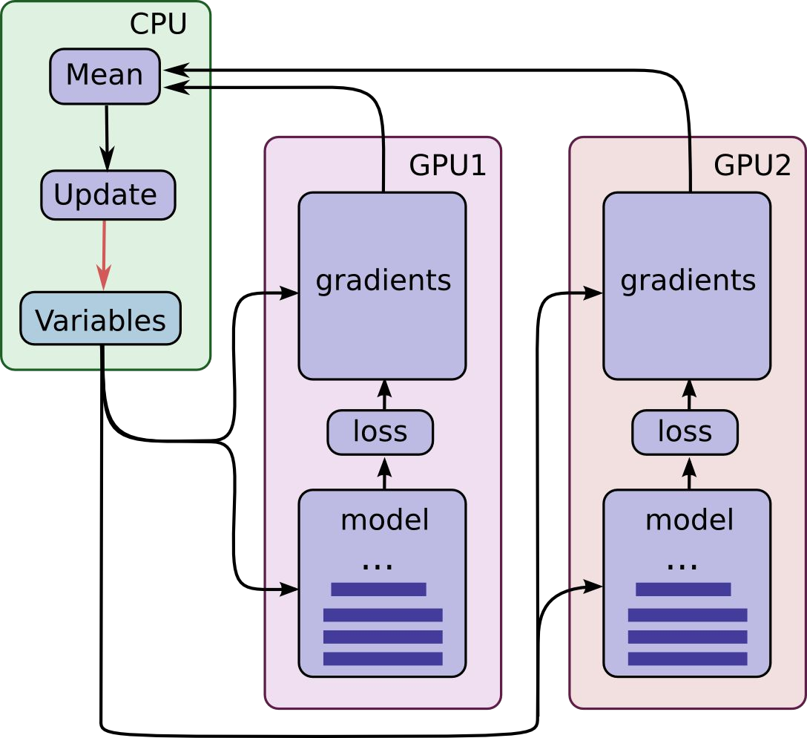
Built-in multi-GPU support

Slide 47
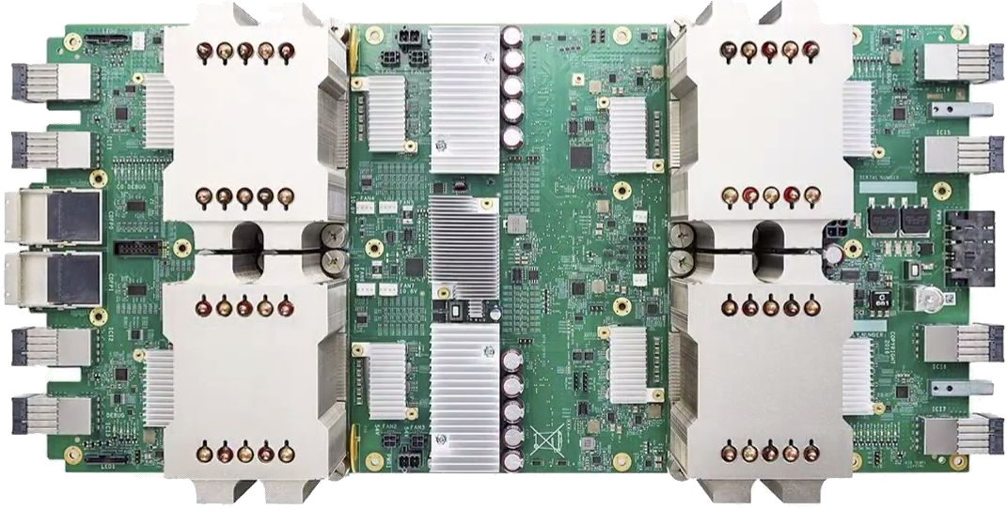
TPU support
Training + inference
Via Estimator API

Slide 48
Eager execution

Slide 49
Understanding deferred (symbolic) vs. eager (imperative)
Deferred: you use Python to build a computation graph that gets executed later
Eager: the Python runtime is the execution runtime (like Numpy) In short:
Symbolic tensors don’t have a value in your Python code (yet)
Eager tensors have a value in your Python code
With eager execution, you can use value-dependent dynamic topologies (tree-RNNs)

Slide 50
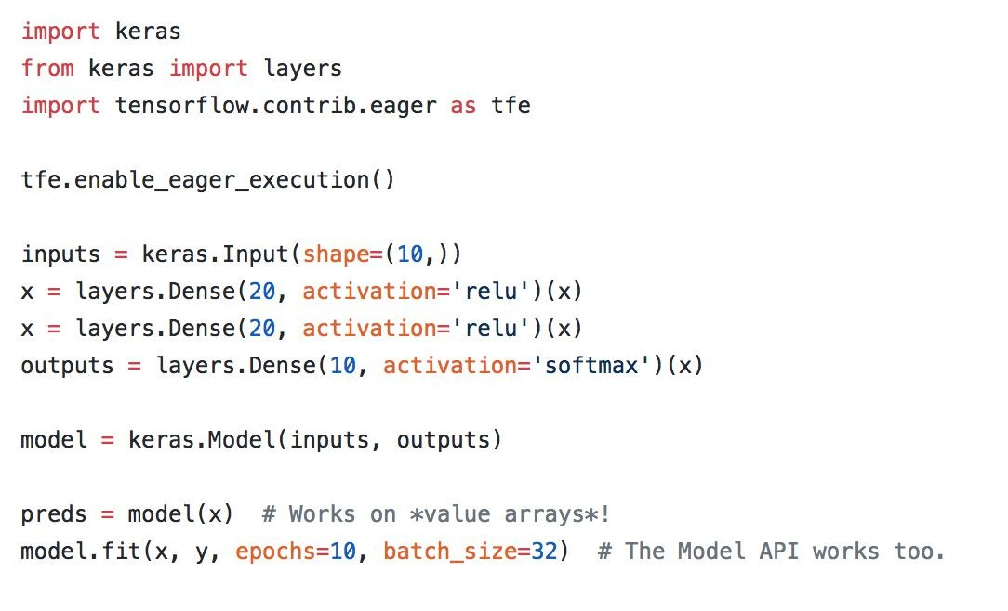
The Keras functional API and Sequential API work with eager execution

Slide 51
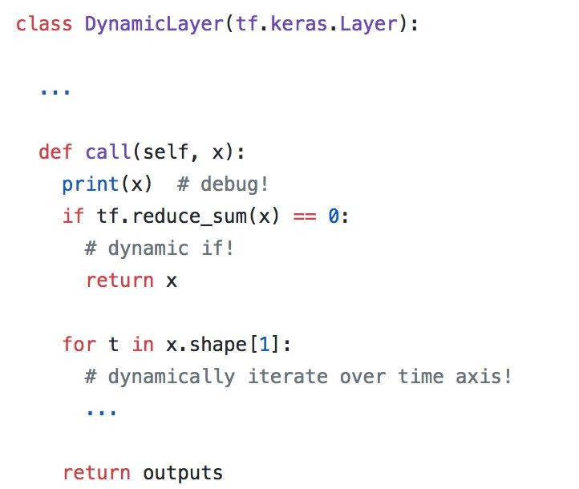
Eager execution allows you to write imperative custom layers

Slide 52
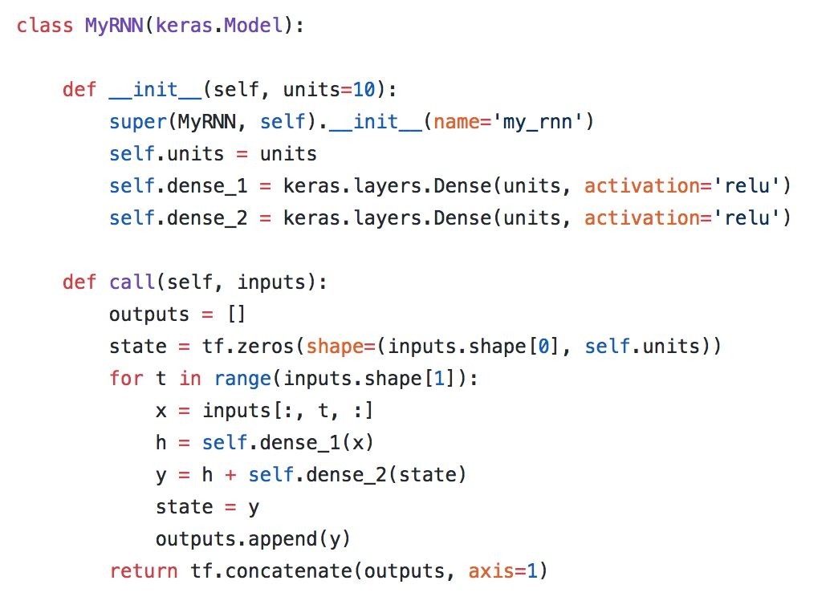
Maximum flexibility: imperative Model subclassing

Slide 53
That’s it. Thank you!

